Slide 1

Smart Vending Machine
Software For Specially Abled

Slide 2
Problem Statement
From what we have recognized whenever a specially abled person is trying to use a vending machine Interface he/she faces difficulty in using even the most simplest interfaces for normal people.When we talk about any automated system our first aim is to provide people an easy interface accessible by all which we see lacking in the normal vending machines or any commonly used software.

Slide 3
Our Solution
Our software provide users with an easy interface , using head movements as cursor movements and eye blinks for product selection and confirmation.The main motive of our software is to elevate the customer experience, to reduce the problems faced by specially abled section of the society, and to improve the efficiency of the operations. We aim to provide a specially abled person a friendly software for a hassle free & fast experience for all kinds of customers.

Slide 4
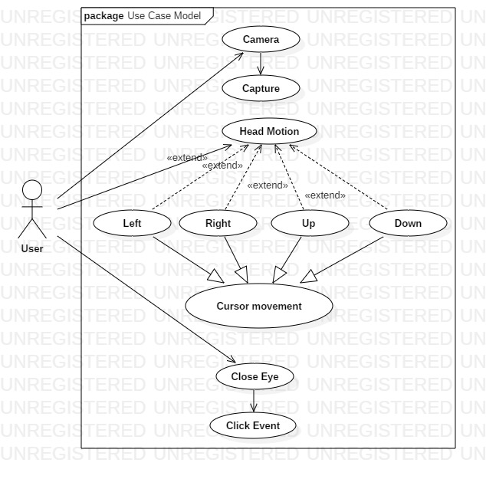

Application Model

Slide 5
Future Scope
Develop this model as a full fledged application
Make it more user friendly and enhancement of UI
Integrating more features :
Sign language to text
Text to voice functionality
Typing through gestures by hands
Accuracy improvement

Slide 6
It’s time for Demo

Slide 7
Q/A Time

